Slide 1
The Modbus RTU Protocol
IIOT Group 4

Slide 2
The Team

Slide 3

Brieuc pesnel
Age: 21 Years
Engineering school in Computer Science at Telecom Saint-Etienne
Specialization: Computer Engineering
Hobbies
  Sport
  Bridge
Technical strengths:
  Programming in pyhton / java / javascript
  Network and information system
  Linux distribution
  Project management
Futur internship in Naval Group (project management in information system)
Notes:
Presentation Pesnel :
France (in the region « Bretagne » west of France)
Last year of engineering school at Telecom Saint-Etienne in computer science, specialize in network
Have been won the France young championship of bridge (play since 12 years), and like running, climbing and karaté
Will make for an internship at Naval group in communication system for warship and want work them after this internship

Slide 4


Devraj ajaykumar solanki
CCCE- Control Engineering.
I am from Surat, Gujarat , India.
I am 21 year old.
I have completed Diploma and BE in Electrical engineering.
Project : Smart leakage current indication & protection system
Hobbies : Gym, Trekking, Sport, Travelling

Slide 5
Mary Sutharshini Thevathas
Country : Sri Lanka
Bachelor in Electrical Power generation Engineering
Completed training in Hydro powerplants.
Current study : CCCE, Communication Engineering
Hobbies : Travelling, Music

Slide 6

Axit Kakadiya
Age: 24 Years.
I am from India. I live in Dhoraji which is a city in Gujarat state.
Bachelor of Engineering – Instrumentation and Control Engineering
Bachelor Project – Automatic Chemical Mixing and Filling using PLC
Hobbies – Sports (Cricket, Football, and badminton), Reading books and Cooking

Slide 7


Robin Dietzel
Age: 23 Years
Bachelor in Computer Science
Specialization: Computer Engineering
Hobbies
  PV offgrid system, Smart-Home
  Server administration
  Home brewing
Technical strengths:
  Programming in C++/C
  Git
  Network and server administration
  Linux
Employee at ZES ZIMMER Electronic Systems GmbH

Slide 8
RS485

Slide 9
Introduction to RS485
A Brief Overview of RS-485 Communication Protocol
It was created for improvement of RS-232
It was created by the Telecommunications Industry Association and Electronic Industries Alliance (TIA/EIA)
It is also referred as RS-485, TIA/EIA-485, TIA - 485
It works as a Master slave module protocol
Axit Kakadiya

Slide 10
Advantage of RS-485
  Allows reliable serial communication on a 2-wire network
  Distance up to 1200m
  Data rate up to 10Mbps
  Up to 32-line device
  Allow good communication in Noisy Environment
  Worked in Half duplex mode but can work Full duplex mode also(with 4 Pin)
Axit Kakadiya

Slide 11
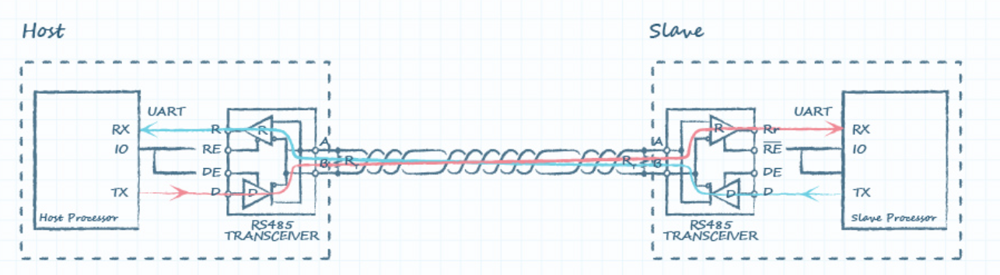
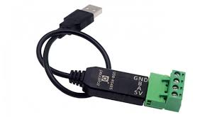
Communication Diagram
USB to RS485 Converter in the R414A01 Module
Axit Kakadiya

Slide 12
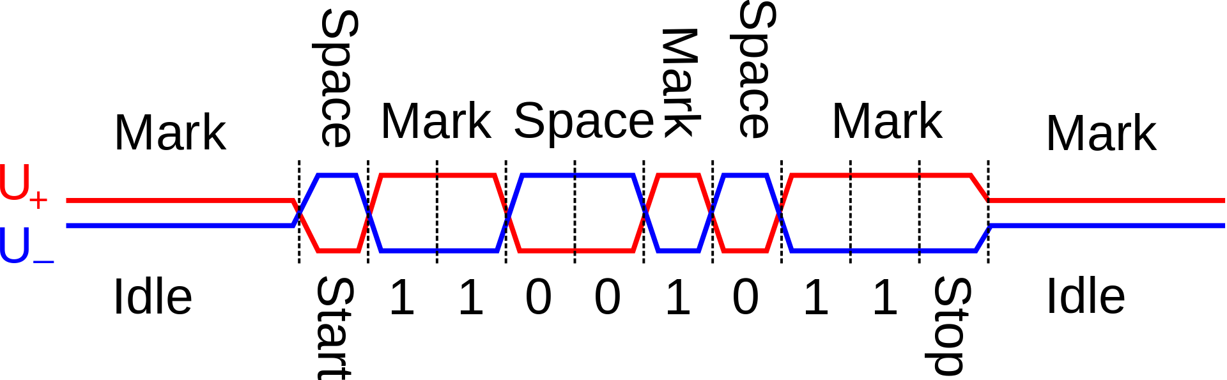
Signal Transmission
Axit Kakadiya

Slide 13
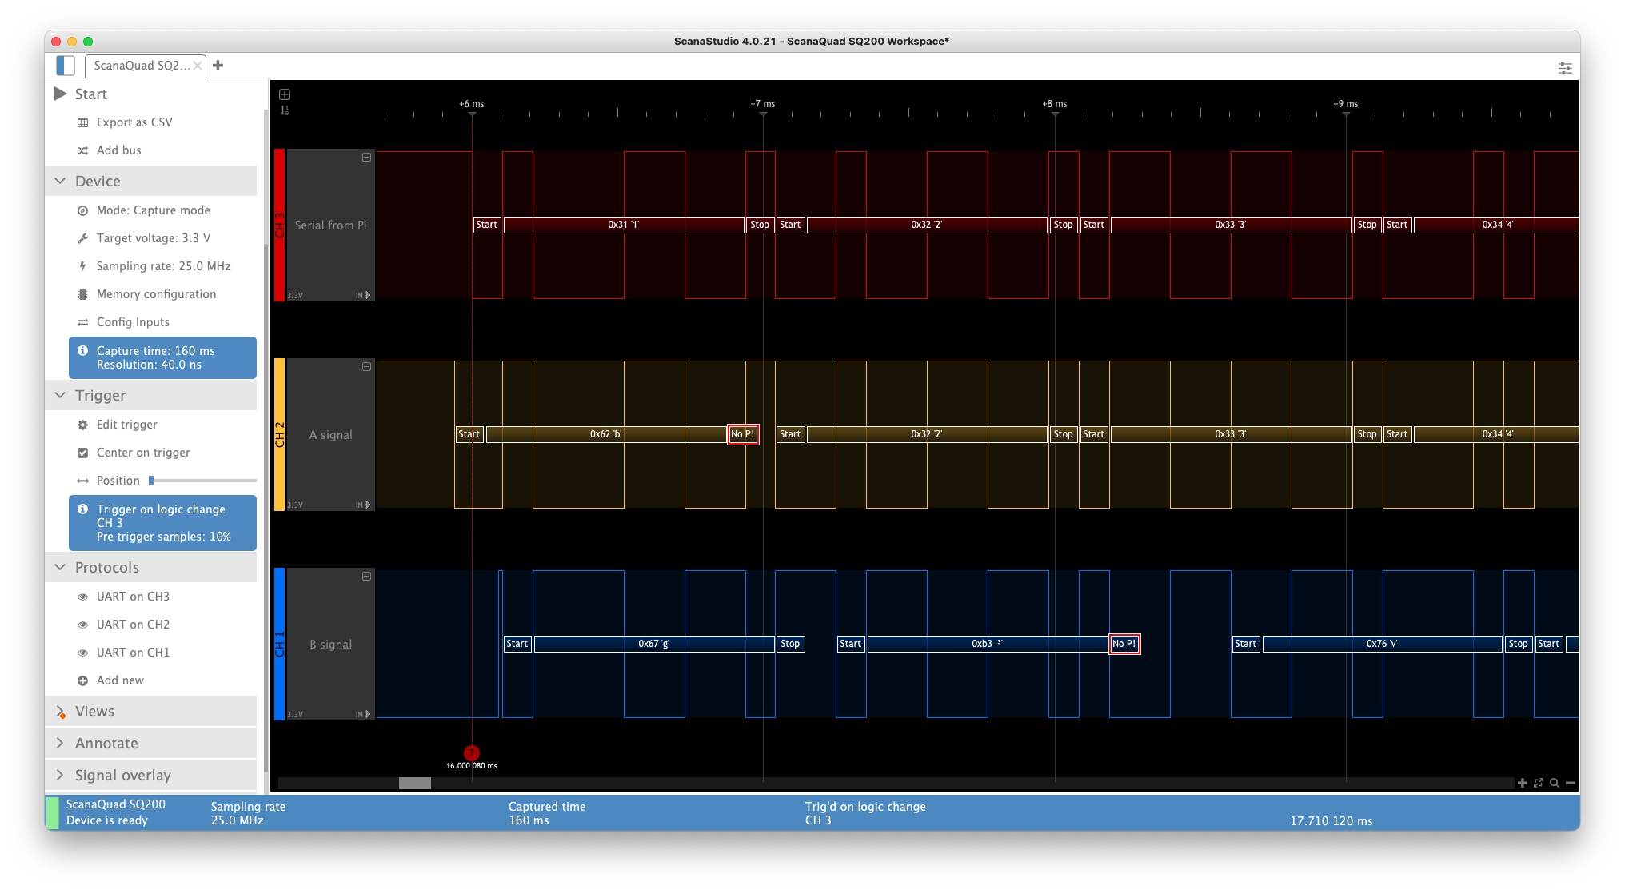
Axit Kakadiya

Slide 14
Modbus Data Link Layer

Slide 15
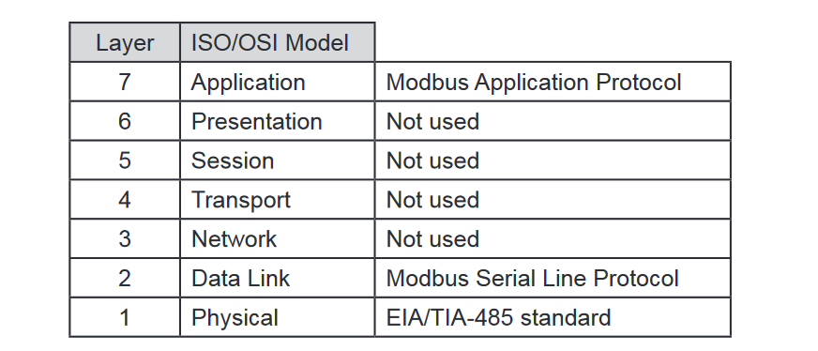
Modbus RTU
Brieuc Pesnel

Slide 16
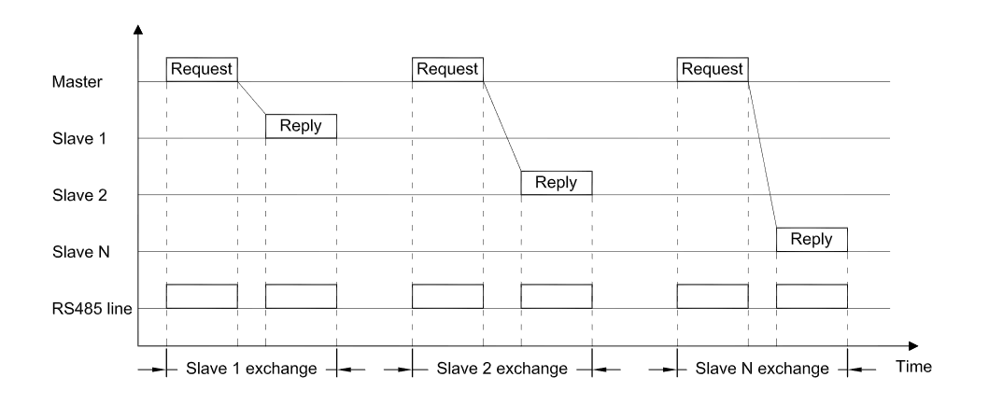
Modbus RTU (Data Link Layer) : A master / slave communication
Brieuc Pesnel

Slide 17
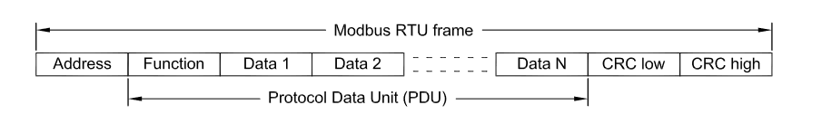
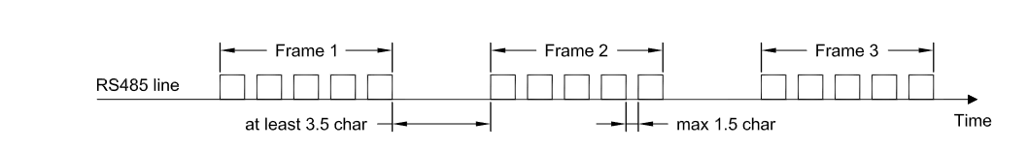
Modbus RTU (Data Link Layer) : Frame
1 Byte for address :
0 broadcast for slave
1 – 247 unicast
248 – 255 unpossible
Brieuc Pesnel

Slide 18
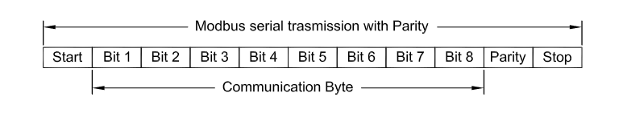
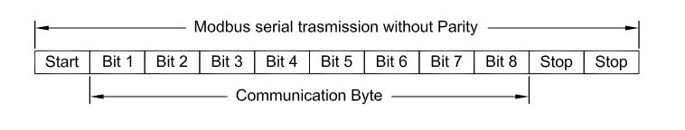
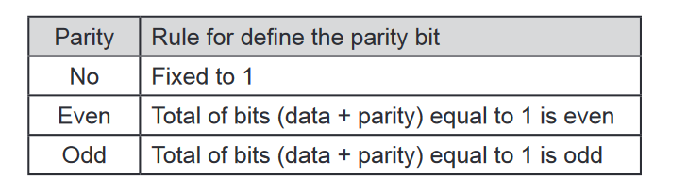
Modbus RTU (Data Link Layer) : Each byte of Frame
Brieuc Pesnel

